Slide 2

Introduction to
Data Science
(IT4142E)

Slide 3
Contents
Lecture 1: Overview of Data Science
Lecture 2: Data crawling and preprocessing
Lecture 3: Data cleaning and integration
Lecture 4: Exploratory data analysis
Lecture 5: Data visualization
Lecture 6: Multivariate data visualization
Lecture 7: Machine learning
Lecture 8: Big data analysis
Lecture 9: Capstone Project guidance
Lecture 10+11: Text, image, graph analysis
Lecture 12: Evaluation of analysis results

Slide 4
Learning outcomes
Understand key elements in exploratory data analysis (EDA)
Explain and use common summary statistics for EDA
Plot and explain common graphs and charts for EDA

Slide 5
Motivation
Before making inferences from data it is essential to examine all your variables.
To understand your data
Why?
To listen to the data:
to catch mistakes
to see patterns in the data
to find violations of statistical assumptions
to generate hypotheses
…and because if you don’t, you will have trouble later
Notes:
If you are going to find out anything about a data set you must first
understand the data
• but most interesting data sets are too big to inspect manually
The EDA approach allows the data to suggest admissible models that best fit the data.
Exploratory Data Analysis (EDA) is an approach/philosophy
for data analysis that employs a variety of techniques (mostly
graphical) to
1. maximize insight into a data set;
2. uncover underlying structure;
3. extract important variables;
4. detect outliers and anomalies;
5. test underlying assumptions;
6. develop parsimonious models; and
7. determine optimal factor settings.

Slide 6
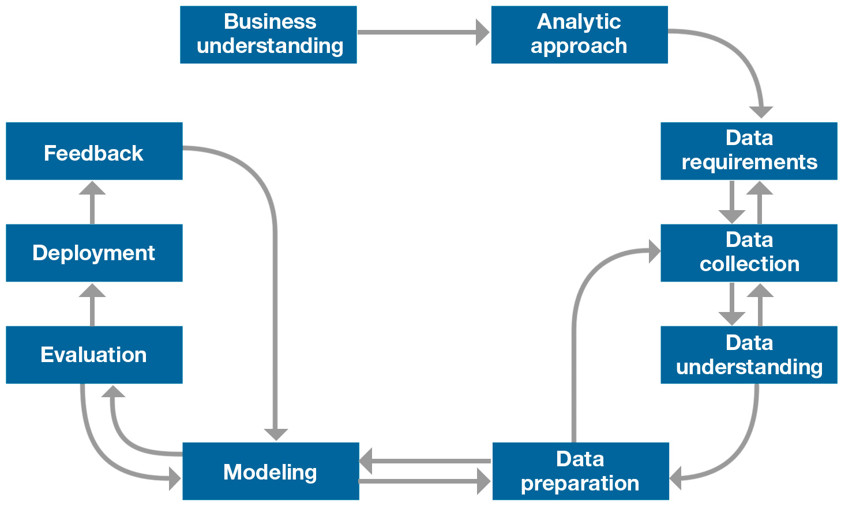
Data science process
1. Formulate a question
4. Product
2. Gather data
3. Analyze data
Source: Foundational Methodology for Data Science, IBM, 2015

Slide 7
Exploratory data analysis (EDA) focus
The focus is on the data—its structure, outliers, and models suggested by the data.
EDA approach makes use of (and shows) all of the available data. In this sense there is no corresponding loss of information.
Summary statistics
Visualization
Clustering and anomaly detection
Dimensionality reduction

Slide 8
EDA definition
The EDA is precisely not a set of techniques, but an attitude/philosophy about how a data analysis should be carried out.
Helps to select the right tool for preprocessing or analysis
Makes use of humans’ abilities to recognize patterns in data

Slide 9
EDA common questions
What is a typical value?
What is the uncertainty for a typical value?
What is a good distributional fit for a set of numbers?
Does an engineering modification have an effect?
Does a factor have an effect?
What are the most important factors?
Are measurements coming from different laboratories equivalent?
What is the best function for relating a response variable to a set of factor variables?
What are the best settings for factors?
Can we separate signal from noise in time dependent data?
Can we extract any structure from multivariate data?
Does the data have outliers?
Notes:
A critical early step in any analysis is to identify (for the
engineering problem at hand) which of the above questions
are relevant. That is, we need to identify which questions we
want answered and which questions have no bearing on the
problem at hand. After collecting such a set of questions, an
equally important step, which is invaluable for maintaining
focus, is to

Slide 10
EDA is an iterative process
Repeat...
Identify and prioritize relevant questions in decreasing order of importance
Ask questions
Construct graphics to address questions
Inspect “answer” and derive new questions

Slide 11
EDA strategy
Examine variables one by one, then look at the relationships among the different variables
Start with graphs, then add numerical summaries of specific aspects of the data
Be aware of attribute types
Categorical vs. Numeric
Notes:
One of the most important step for any data science project is undertaking Exploratory Data Analysis(EDA). According to John Tukey ,
“Exploratory data analysis is an attitude , a state of flexibility, a willingness to look for those things that we believe are not there, as well as those we believe to be there”

Slide 12
EDA techniques
Graphical techniques
scatter plots, character plots, box plots, histograms, probability plots, residual plots, and mean plots.
Quantitative techniques
Notes:
EDA techniques are generally graphical. They include scatter plots, character plots, box plots, histograms, bihistograms, probability plots, residual plots, and mean plots.

Slide 13
Describing univariate data

Slide 14
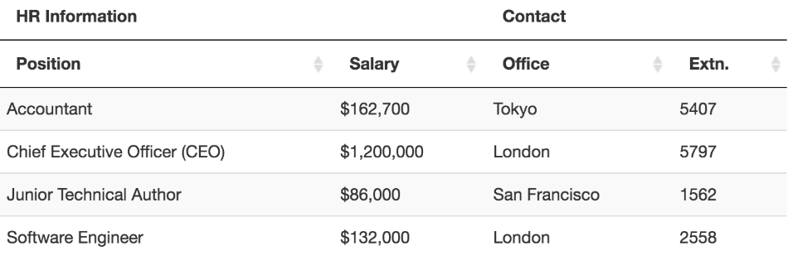
Observations and variables
Data is an collection of observations
an attribute is thought of as a set of values describing some aspect across all observations, it is called a variable

Slide 15
Types of variables

Slide 16
Dimensionality of data sets
Univariate: Measurement made on one variable per subject
Bivariate: Measurement made on two variables per subject
Multivariate: Measurement made on many variables per subject

Slide 17
Measures of central tendency
Measures of Location: estimate a location parameter for the distribution; i.e., to find a typical or central value that best describes the data.
Measures of Scale: characterize the spread, or variability, of a data set. Measures of scale are simply attempts to estimate this variability.
Skewness and Kurtosis
Notes:
Central Tendency measures. They are computed
to give a “center” around which the measurements in
the data are distributed.
• Variation or Variability measures. They describe
“data spread” or how far away the measurements are
from the center.
• Relative Standing measures. They describe the
relative position of specific measurements in the data.
Skewness is a measure of symmetry. A distribution, or data set, is symmetric if it looks the same to the left and right of the center point
Kurtosis is a measure of whether the data are peaked or flat relative to a normal distribution. data sets with high kurtosis tend to have a distinct peak near the mean, decline rather rapidly, and have heavy tails. Data sets with low kurtosis tend to have a flat top near the mean rather than a sharp peak.
Randomness
Distributional Measures
Outliers

Slide 18
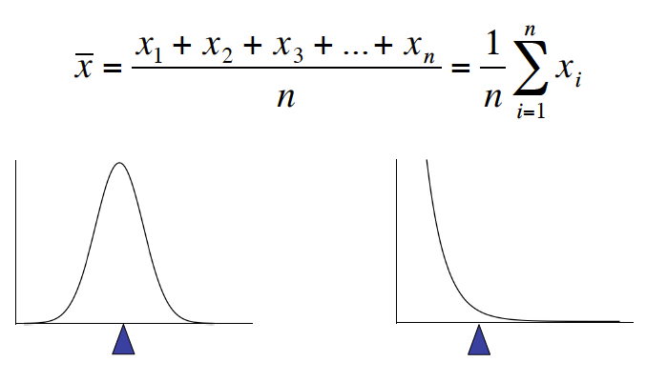
Mean
To calculate the average value of a set of observations, sum of their values divided by the number of observations:
Notes:
Trung binh

Slide 19
Median
The median is the value of the point which has half the data smaller than that point and half the data larger than that point.
Calculation
If there are an odd number of observations, find the middle value
If there are an even number of observations, find the middle two values and average them
Example
Age of participants: 17 19 21 22 23 23 23 38
Median = (22+23)/2 = 22.5
Notes:
Trung vi

Slide 20
Mode
mode is the most commonly reported value for a particular variable
Eg. 3, 4, 5, 6, 7, 7, 7, 8, 8, 9. Mode = 7
Eg. 3, 4, 5, 6, 7, 7, 7, 8, 8, 8, 9. Mode = {7, 8} = 7.5

Slide 21
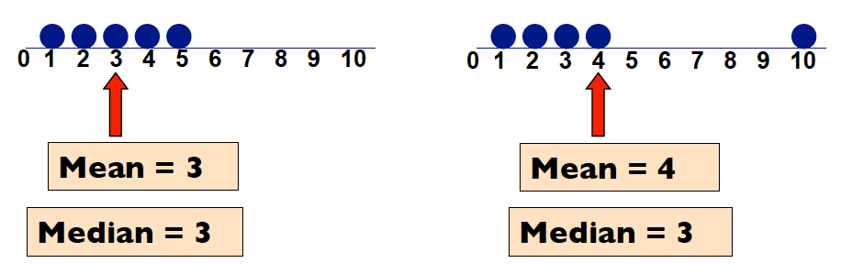
Which location measure is best?
Mean is best for symmetric distributions without outliers
Median is useful for skewed distributions or data with outliers

Slide 22
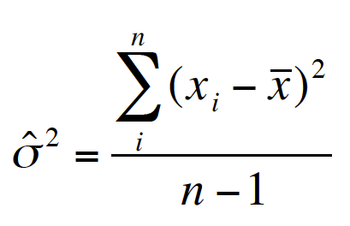
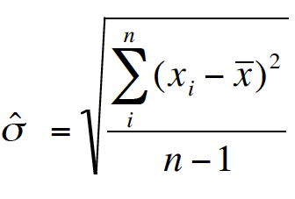
Measure of scale : Variance and standard deviation
Variance: average of squared deviations of values from the mean
Standard Deviation: simply the square root of the variance
Notes:
Why Squared Deviations? Variance do lech (Phuong sai) , standard deviation do lech chuan
Adding deviations will yield a sum of ?
• Absolute values do not have nice mathematical
properties
• Squares eliminate the negatives
• Result:
– Increasing contribution to the variance as you go
farther from the mean.
Variance is somewhat arbitrary
What does it mean to have a variance of 10.8? Or 2.2? Or 1459.092? Or 0.000001?
Nothing. But if you could “standardize” that value, you could talk about any variance (i.e. deviation) in equivalent terms
Standard deviations are simply the square root of the variance

Slide 23
Run sequence plot
displays observed data in a time sequence.
The run sequence plot can be used to answer the following questions
Are there any shifts in location?
Are there any shifts in variation?
Are there any outliers?

Slide 24
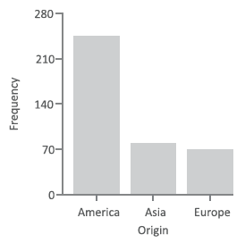
Bar charts
a bar chart displays the relative frequencies for the different values.
or a chart presents categorical data with rectangular bars with heights or lengths proportional to the values that they represent

Slide 25
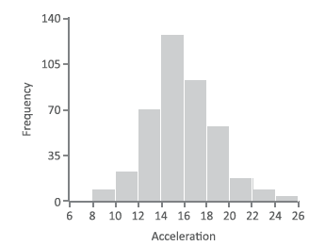
Histogram plot
A histogram is to graphically summarize the distribution of a univariate data set.
The histogram can be used to answer the following questions:
What kind of population distribution do the data come from?
Where are the data located?
How spread out are the data?
Are the data symmetric or skewed?
Are there outliers in the data?
Notes:
The frequency histogram is useful for variables with an ordered scale—
ordinal, interval, or ratio—that contain a larger number of values
the criteria for inclusion within a single bar in histogram is a specific range of values.
The histogram graphically shows the following:
1. center (i.e., the location) of the data;
2. spread (i.e., the scale) of the data;
3. skewness of the data;
4. presence of outliers; and
5. presence of multiple modes in the data.

Slide 26
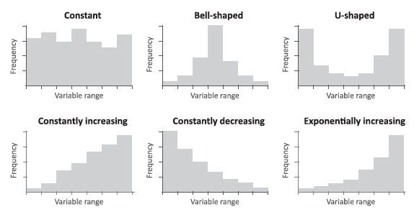
Example of frequency distributions

Slide 27
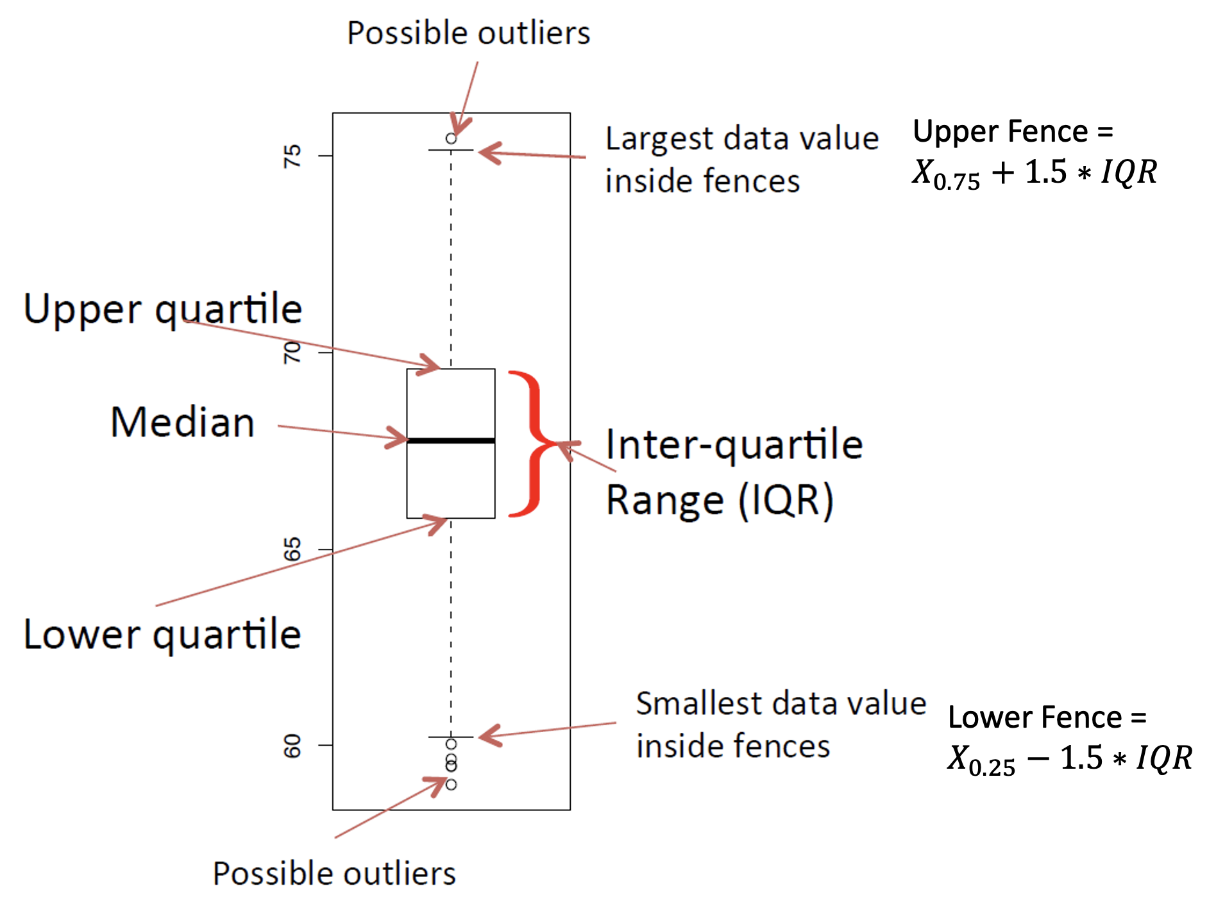
Box plot
Box plot displayed: the lowest value, the lower quartile (Q1), the median (Q2), the upper quartile (Q3), the highest value, and the mean.
Notes:
Quartiles: tứ phân vị, điểm tứ phân vị
Quartiles divide a continuous variable into four even segments based on the number of observations.

Slide 28
Box plot (2)
The box plot can provide answers to the following questions:
Is a factor significant?
Does the location differ between subgroups?
Does the variation differ between subgroups?
Are there any outliers?

Slide 29
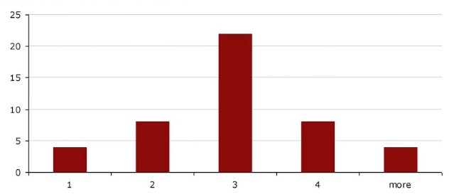
Skewness
Skewness is a measure of asymmetry. A distribution, or data set, is symmetric if it looks the same to the left and right of the center point
Symetrical distribution
Mean = median = mode = 3

Slide 30
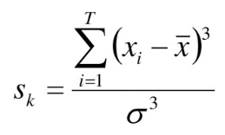
Negative, positive skewness

Slide 31
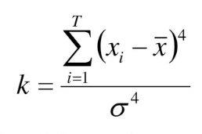
Kurtosis
Kurtosis is a measure of whether the data are peaked or flat relative to a normal distribution. data sets with high kurtosis tend to have a distinct peak near the mean, decline rather rapidly, and have heavy tails. Data sets with low kurtosis tend to have a flat top near the mean rather than a sharp peak.

Slide 32
Understanding relationships

Slide 33
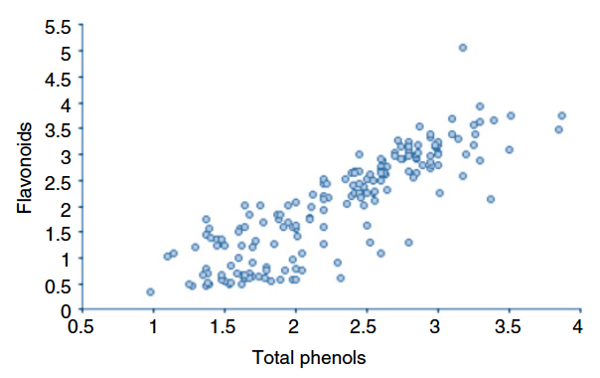
Scatter plot
identify whether a relationship exists between two continuous variables measured on the ratio or interval scales
two variables are plotted on the x-and y-axis
each point is a single observation.

Slide 34
Scatter plot
Scatter plots can provide answers to the following questions:
Are variables X and Y related?
Are variables X and Y linearly related?
Are variables X and Y non-linearly related?
Does the variation in Y change depending on X?
Are there outliers?

Slide 35
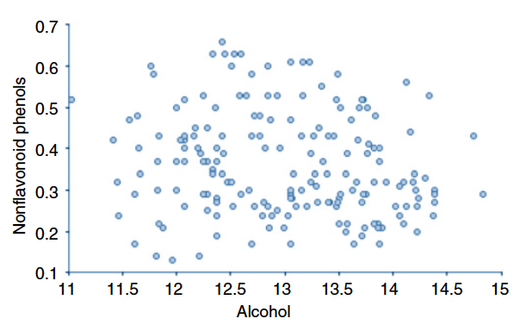
Scatter plot: No relationship

Slide 36
Scatter plot: Strong linear (positive - negative correlation)

Slide 37
Scatter plot: Sinusoidal relationship (damped)

Slide 38
Scatter plot: variation of Y does not depend on X (homoscedastic)

Slide 39
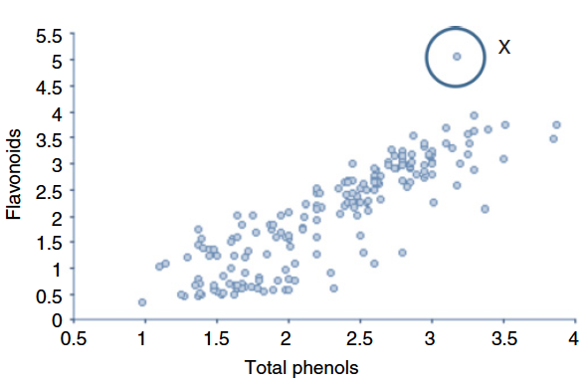
Scatter plot: Outlier

Slide 40
Scatterplot matrix
a collection of scatterplots organized into a grid (or matrix).
Each scatterplot shows the relationship between a pair of variables

Slide 41
Lag plot
For data values Y₁, Y₂, …, Y_{N}, the k-period (or k^{th}) lag of the value Y_{i} is defined as the data point that occurred k time points before time i. That is Lag_{𝑘}(𝑌_{𝑖}) = 𝑌_{𝑖−𝑘} For example, Lag₁(𝑌₂) = 𝑌₁ and Lag₃(𝑌₁₀) = 𝑌₇
Lag plots can provide answers to the following questions:
1. Are the data random?
2. Is there serial correlation in the data?
3. What is a suitable model for the data?
4. Are there outliers in the data?

Slide 42
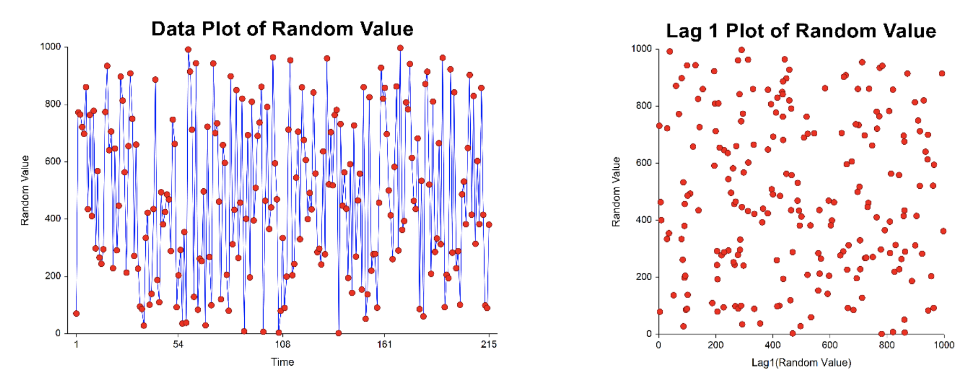
Lag plot patterns
Random Data

Slide 43
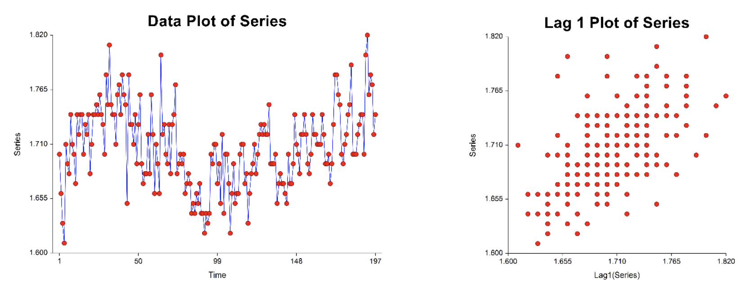
Data with weak autocorrelation

Slide 44
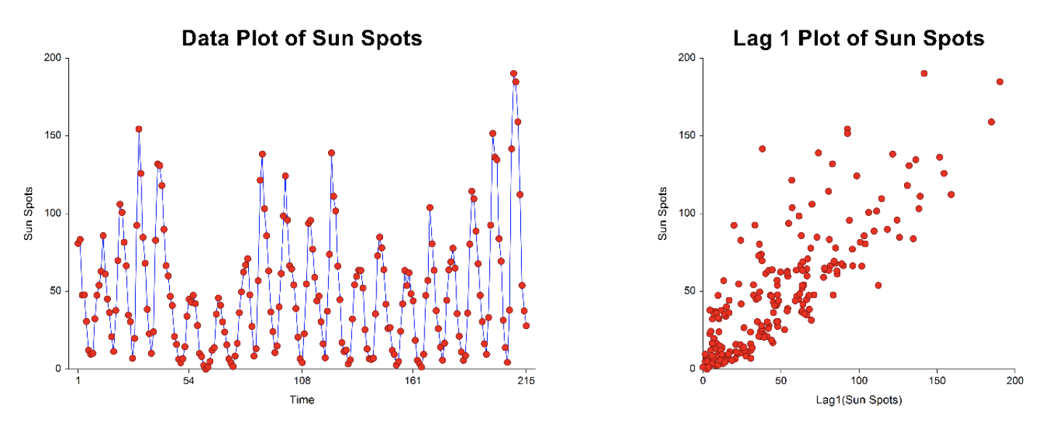
Data with moderate autocorrelation

Slide 45
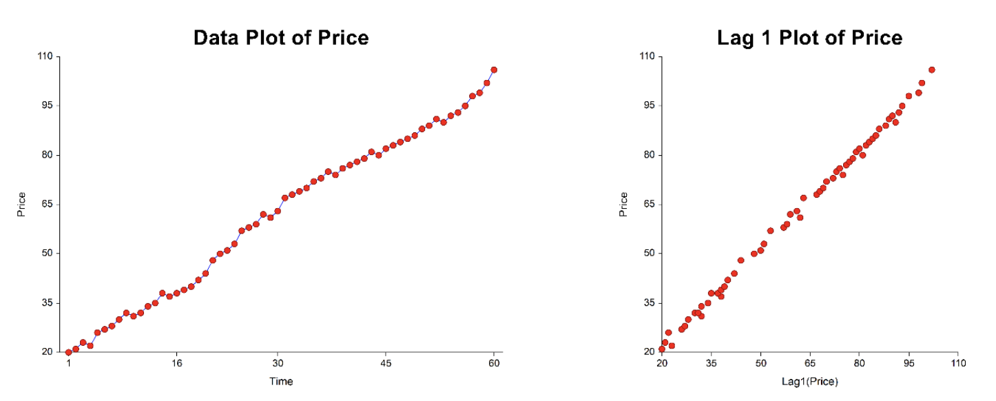
Data with high autocorrelation

Slide 46
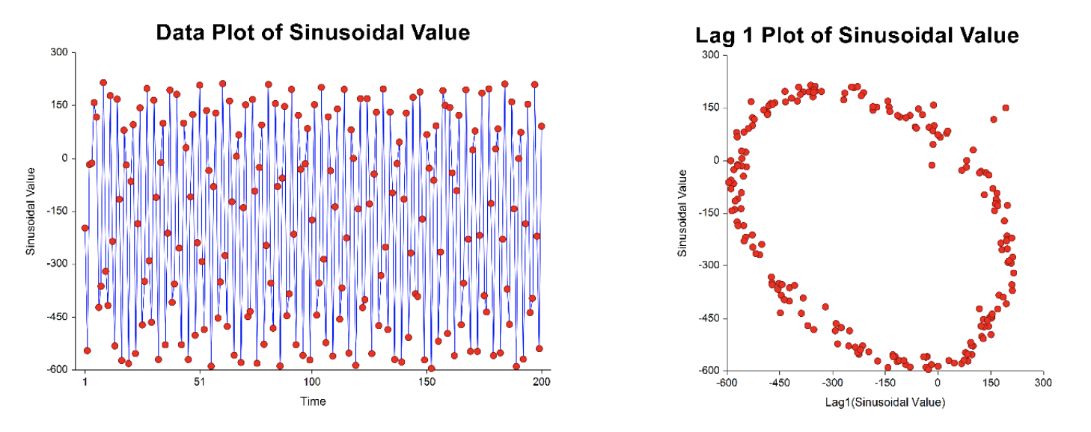
Sinusoidal data

Slide 47
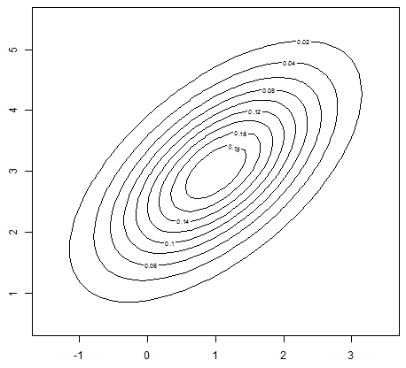
Contour plots
show a three-dimensional surface on a two-dimensional plane. Contour lines indicate elevations that are the same
The contour plot is used to answer the question
How does Z change as a function of X and Y?

Slide 48
Demo

Slide 49
Identifing and understanding groups
Clustering Methods in Exploratory Analysis
Notes:
often useful to decompose a data set into simpler subsets to help make
sense of the entire collection of observations. These groups may reflect
the types of observations found in a data set. For example, the groups
might summarize the different types of customers who visit a particular
shop based on collected demographic information

Slide 50
Motivation
Decomposing a data set into simpler subsets helps make sense of the entire collection of observations
uncover relationships in the data such as groups of consumers who buy certain combinations of products
identify rules from the data
discover observations dissimilar from those in the major identified groups (possible errors or anomalies)

Slide 51
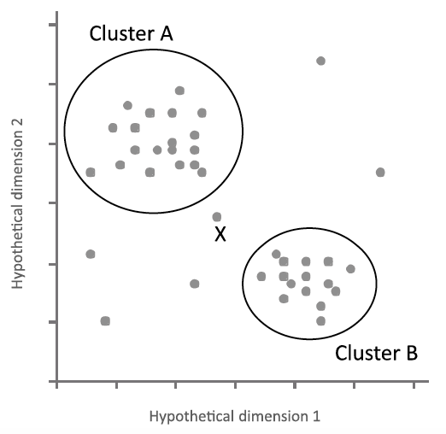
Clustering
A way of grouping together data samples that are similar in some way - according to some criteria
A form of unsupervised learning – you generally don’t have examples demonstrating how the data should be grouped together

Slide 52
Can we find things that are close together?
Clustering organizes things that are close into groups
How do we define close?
How do we group things?
How do we visualize the grouping?
How do we interpret the grouping?
Notes:
In machine learning (ML) literature, clustering is one of the methods that is normally used in unsupervised learning with the aim of learning the underlying hidden structures of the data and its categorization.
how can we choose the best clustering algorithm for our data analysis task? and how can we assess the best number of clusters ?
grouping sets of data objects with the aim of finding relationships within the objects that compose the data
to find similarities within the data, draw inferences, find hidden patterns and also to reconstruct a possibly underlying data structure

Slide 53
Types of clustering
Hierarchical clustering
Flat clustering

Slide 54
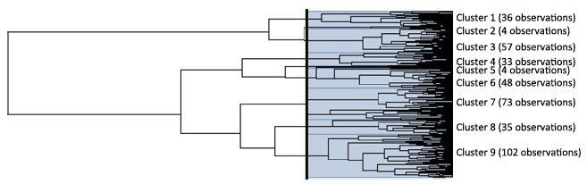
Hierarchical clustering
An agglomerative approach
Find closest two things
Put them together
Find next closest
Requires
A defined distance
A merging approach
Produces
A tree showing how close things are to each other (dendrogram)

Slide 55
Distances
A method of clustering needs a way to measure how similar observations are to each other.
Continuous - Euclidean distance
Continuous - correlation similarity
Binary - Manhattan distance
Pick a distance/similarity that makes sense for the problem

Slide 56
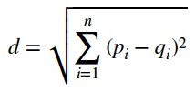
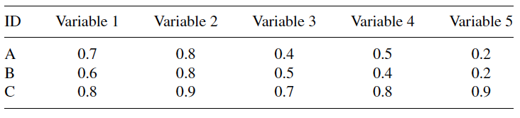
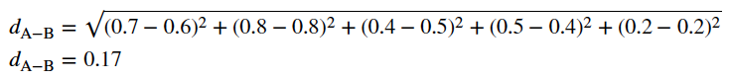
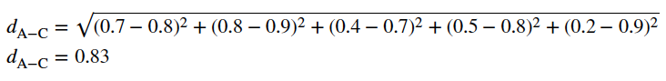
Euclidean distance

Slide 57
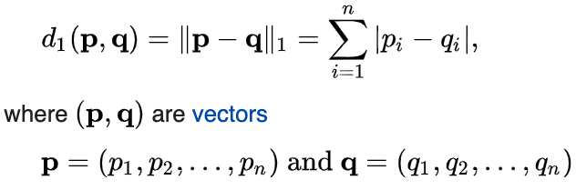
Manhattan distance
is the sum of the lengths of the projections of the line segment between the points onto the coordinate axes
Notes:
Taxicab geometry versus Euclidean distance: In taxicab geometry, the red, yellow, and blue paths all have the same shortest path length of 12. In Euclidean geometry, the green line has length {\displaystyle 6{\sqrt {2}}\approx 8.49} and is the unique shortest path.

Slide 58
Cosine distance

Slide 59
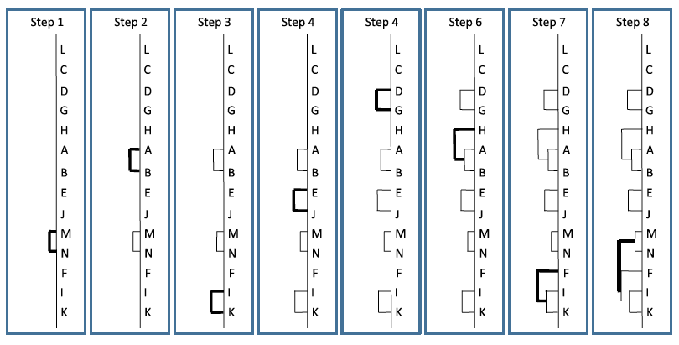
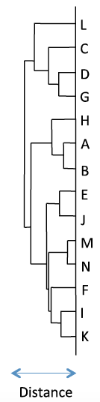
Agglomerative Hierarchical Clustering Algorithm

Slide 60
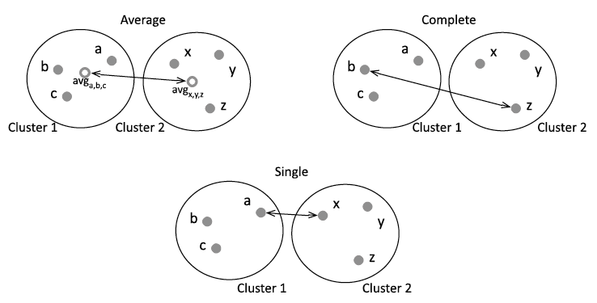
Linkage rules

Slide 61
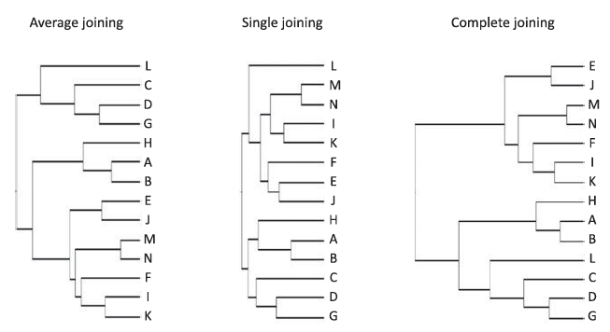
AHC result

Slide 62
K-mean clustering
A partitioning approach
Fix a number of clusters
Get “centroids” of each cluster
Assign things to closest centroid
Recalculate centroids
Requires
A defined distance metric
A number of clusters
An initial guess as to cluster centroids
Produces
Final estimate of cluster centroids
An assignment of each point to clusters

Slide 63
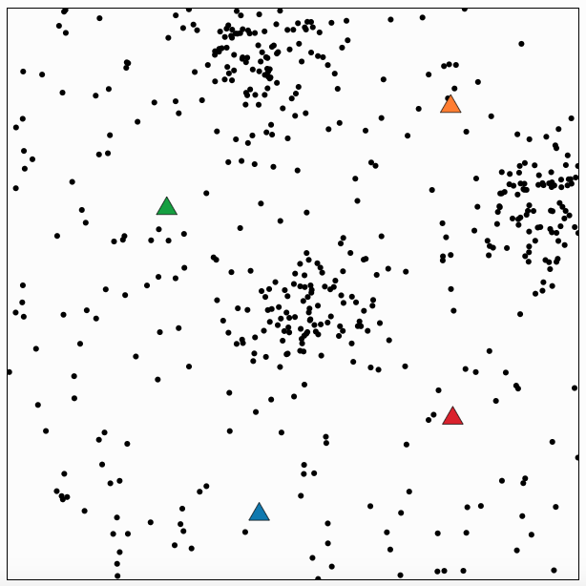

Slide 64
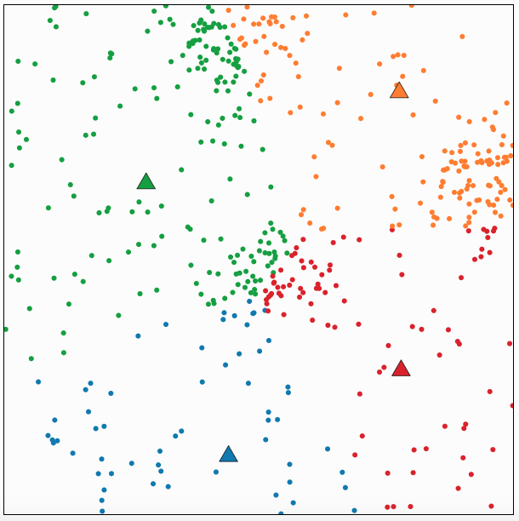

Slide 65
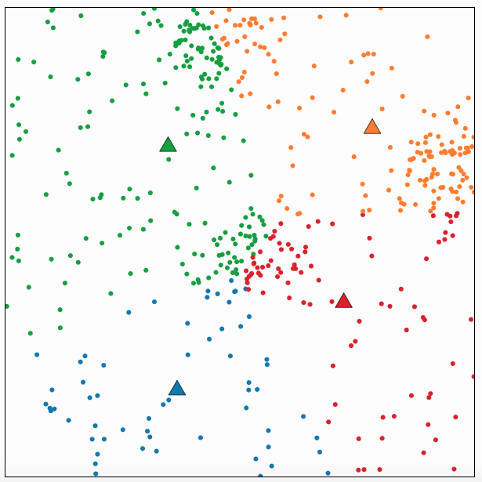

Slide 66
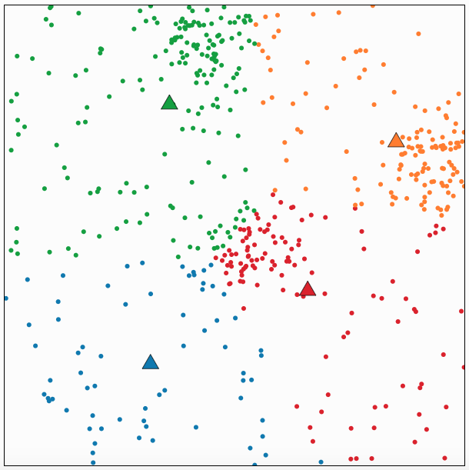

Slide 67
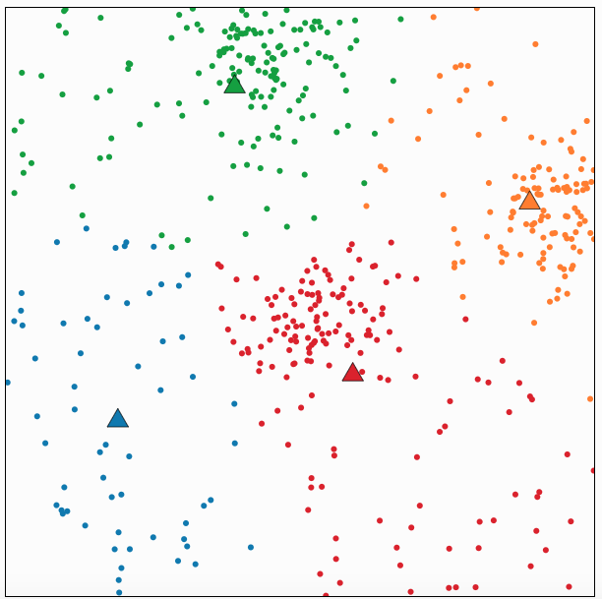

Slide 68
Dimensionality reduction
Principal Components Analysis and Singular Value Decomposition

Slide 69
Motivation
Most machine learning and data mining techniques may not be effective for high-dimensional data
Curse of Dimensionality. Irrelevant and redundant features can “confuse” learners!
The intrinsic dimension may be small.
Notes:
Many explored domains have hundreds to tens of thousands of variables/features with many irrelevant and redundant ones!
- In domains with many features the underlying probability distribution can be very complex and very hard to estimate (e.g. dependencies between variables) !
Irrelevant and redundant features can “confuse” learners!
Limited training data!
Limited computational resources!

Slide 70
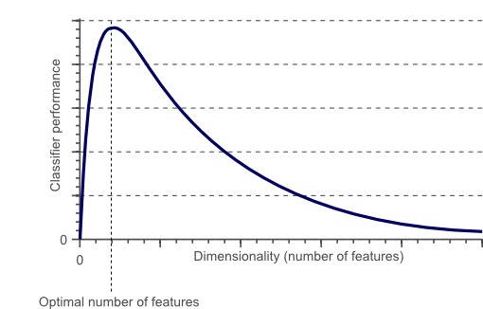
Curse of dimensionality
The required number of samples (to achieve the same accuracy) grows exponentionally with the number of variables!
In practice: number of training examples is fixed!
=> the classifier’s performance usually will degrade for a large number of features!
After a certain point, increasing the dimensionality of the problem by adding new features would actually degrade the performance of classifier.

Slide 71
Motivation
Dimensionality reduction is an effective approach to downsizing data
Visualization: projection of high-dimensional data onto 2D or 3D.
Data compression: efficient storage and retrieval.
Noise removal: positive effect on query accuracy.
Notes:
It is so easy and convenient to collect data
Data is not collected only for data mining
Data accumulates in an unprecedented speed
Data pre-processing is an important part for effective machine learning and data mining
Dimensionality reduction is an effective approach to downsizing data

Slide 72
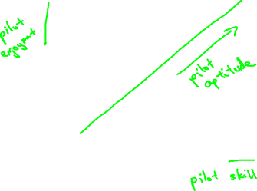
Data compression
Reduce data from
2D to 1D
(inches)
(cm)

Slide 73
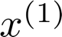
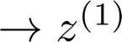
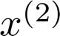
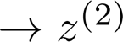
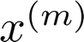
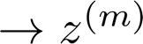
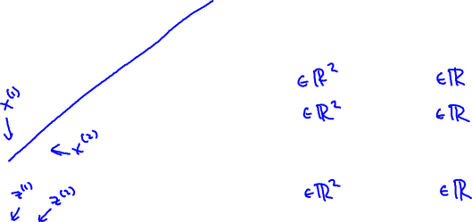
Data compression (2)
Reduce data from
2D to 1D
(inches)
(cm)
Notes:
Add more unique colors (3-4)

Slide 74
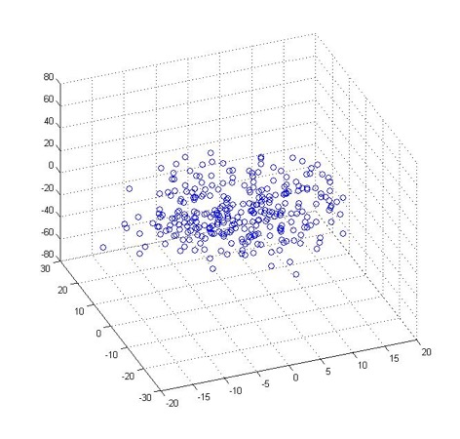
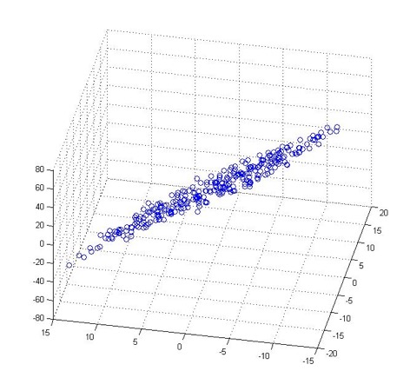
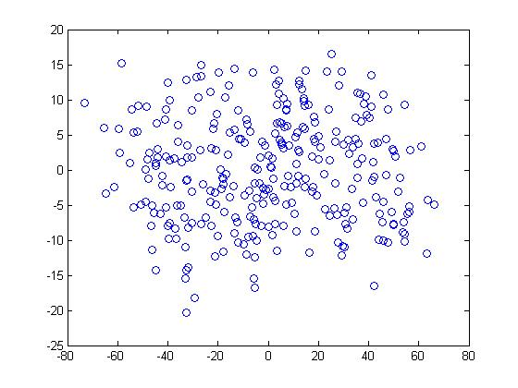

Data compression (2)
Reduce data from 3D to 2D
Notes:
Pca3d2d in lecture-slides/assets/pca/
Label axes

Slide 75

Principal Component Analysis (PCA) problem formulation
Notes:
Reduce from 2-dimension to 1-dimension: Find a direction (a vector )
onto which to project the data so as to minimize the projection error.

Slide 76




Principal Component Analysis (PCA) problem formulation
Reduce from 2-dimension to 1-dimension: Find a direction (a vector )
onto which to project the data so as to minimize the projection error.
Reduce from n-dimension to k-dimension: Find vectors
onto which to project the data, so as to minimize the projection error.
Notes:
Change numbers to LATEX as well

Slide 77
Demo

Slide 78




References

Slide 79
Thank you for your attention!
Q&A

Slide 80
Exploratory data analysis in Tableau

Slide 81
CitiesExt.csv
Ten countries with the highest population, bar chart showing populations
Pie chart showing relative number of cities with negative longitude and positive longitude. Label the two slices “west” for west of the Prime Meridian (negative longitude), and “east” for east of the Prime Meridian (positive longitude)
Is there is any relationship between the latitude of cities in a country (x-axis) and the population of that country (y-axis) (scatter plot)

Slide 82
PlayersExt.csv
Create a bar chart showing the average number of minutes played by players in each of the four positions.
Create a stacked bar chart for teams that played more than 4 games, showing their number of wins, draws, and losses.
Create a pie chart showing the relative percentage of teams with 0, 1, and 2 red cards. Note: the pie should have three slices.
Create a scatterplot of players showing passes (y-axis) versus minutes (x-axis). (Why are there some lines of dots?)
Create a map of countries colored light to dark blue based on how many goals their team made (“goalsFor”).
Create a pie chart showing the relative percentage of players making <= 0.25 passes per minute, >= 0.5 passes per minute, and between 0.25 and 0.5.

Slide 83
Lag plot
Lag plots can provide answers to the following questions:
1. Are the data random?
2. Is there serial correlation in the data?
3. What is a suitable model for the data?
4. Are there outliers in the data?

Slide 84
Block plot
Notes:
The block plot can provide answers to the following
questions:
1. Is the factor of interest significant?
2. Does the factor of interest have an effect?
3. Does the location change between levels of the primary
factor?
4. Has the process improved?
5. What is the best setting (= level) of the primary factor?
6. How much of an average improvement can we expect
with this best setting of the primary factor?
7. Is there an interaction between the primary factor and
one or more nuisance factors?
8. Does the effect of the primary factor change depending
on the setting of some nuisance factor?
9. Are there any outliers?

